Slide 1
Deep Log-polar networks

Slide 2
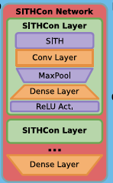
Comparison to SITHCon
SITHCon
Principal operation is log-compression of time series to create f(t, i)
i indexes tau_star
Learned 1D convolution over tau_star, then maxpooling
DeepLP
Principal operation is log-compression of space across rays from a set of angles 𝛉 to create f(x, y, i, j)
i indexes tau_star
j indexes theta
Learned 2D convolution over tau_star+theta, then maxpooling.
DeepLP Network
LPConv Layer
LP Transform
Conv2d
Maxpool2d
Dense Layer
Activation
LPConv Layer
…
Spatial Reduction
Dense Layer (to logits)
single tau_star axis
many tau_star axes

Slide 3
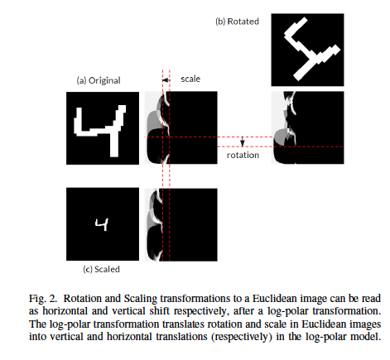
(figure from Remmelzwaal et al.)

Slide 4
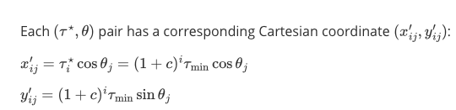
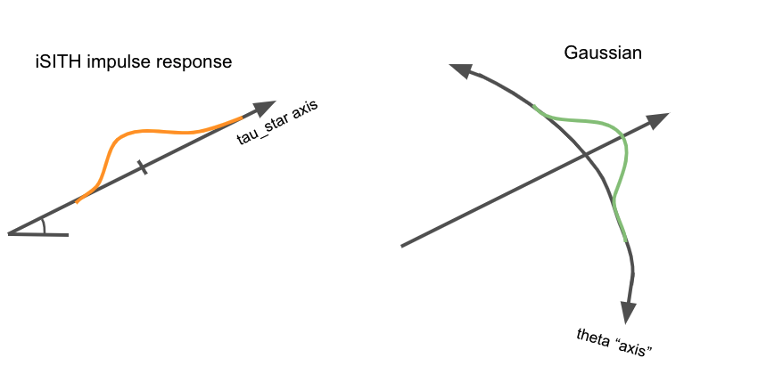
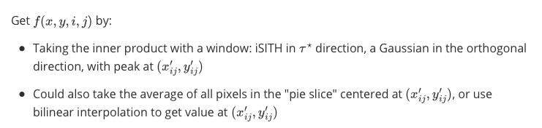
Computing Log-polar transform
(x’₄₀, y’₄₀)
(x, y)

Slide 5

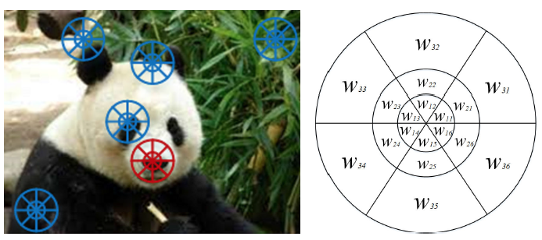
LPConv Layer
Log-polar coordinate transform is computed at every point in the image, resulting in a tensor of size H x W x C_1 x N_tau x N_theta
After conv and pooling, the size is H x W x C_2 x 1 x 1
Computation of log-polar feature map at a single pixel (x, y)
=
N_theta
(x, y)
N_tau
(figure from Su et al., a similar approach but without convolution or max-pooling)

Slide 6
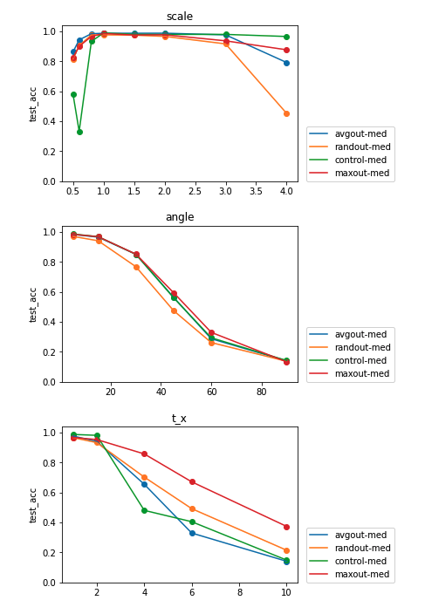
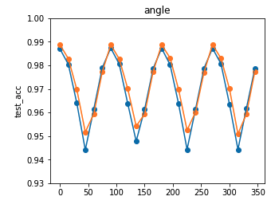
Results on MNIST and RotMNIST
Note: The rotation-invariant tests are with small ntau and tau_max (to reduce on training time). Scale invariance suffers, though.
Using two models, with 148k and 81k parameters, respectively:
Training and testing on both RotMNIST gives 98.5% accuracy for the large model and 97.3% for the medium model
Training on only MNIST, then testing on RotMNIST gives 97.8% and 97.4% accuracy
rotation invariance out-of-the-box from training on non-augmented MNIST
Train small, models (13.5K params) on MNIST, test on rot/scaled/translated images. Comparison of different ways to reduce spatial dimension in last layer (control = choose center pixel). Full max-pooling over only tau dimension.

